Slide 1



RAUKAWA
South Waikato
Water Treatment Plants:
Joint
Decision-making
Journey
DocSet ID: 460296
For:
www.raukawa.org.nz & www.southwaikato.govt.nz
All rights reserved
Notes:
DocSet ID: 460296

Slide 2

AGENDA
Introduction & Acknowledgements
Kupe’s, Cook’s and Aotearoa NZ Law/Lore
History & context
Raukawa
RCT Expectations & Issues
Process
Evaluation criteria
Wastewater Solution
Engagement Process
Learnings
Future
Notes:
Introduction & acknowledgements is of presenters, Raukawa, SWDC and wider teams within/working for those organisations

Slide 3

Kupe’s, Cook’s and Aotearoa NZ Law/Lore
Kupe’s Lore
Aprox. 1200 BC
Cook’s Law
1840
Mid 1980s
Kupe’s lore
Aotearoa/NZ Law/lore
Judge Joe Williams Presentation to RMLA 2015: http://www.tauranga.govt.nz/community/tangata-whenua/resource-management-processes/other-resources

Slide 4
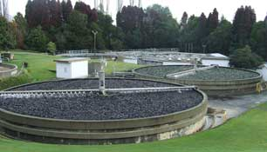
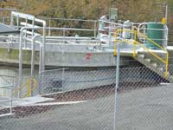
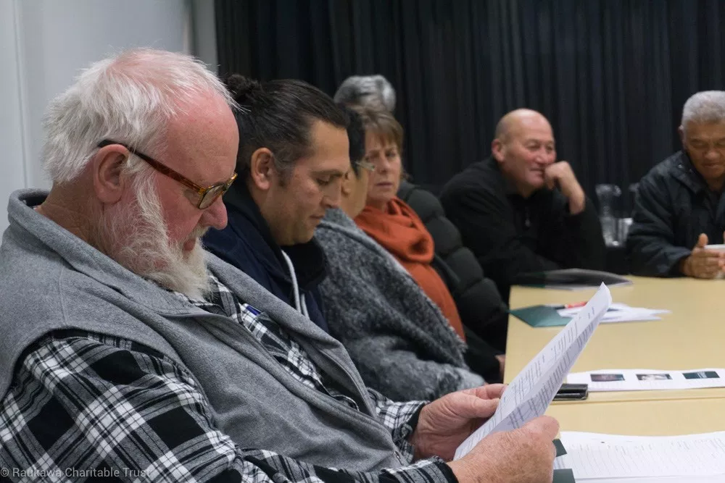
History & context
Wastewater consents expiring or expired
Earlier attempt failed
RMA requirements
Traditional approach: separate Council process/iwi consultation
New approach: Co-governance and joint hui
Notes:
Wastewater consents 2 expiring and 2 expired
Earlier attempt to get buy-in for plant upgrade and resource consent failed – arguable because of commitment and budget implications
Need to cover RMA requirements for engagement and LGA for community engagement
Going to use traditional approach with iwi consultation separate from Council processes but could see major issues around getting agreement
Decision to go down co-governance and joint hui approach taken. Large call because not done before by Council and this is a very large project

Slide 5
Raukawa
Central N.I. Post Settlement Iwi
16 Marae affiliate to RST
Co-Management Deed and Instruments Waikato Awa
Te Rautaki Taiao A Raukawa (Raukawa Environmental Plan)
Restoration and Protection of the Waikato and Waihou Awa
Notes:
Describe:
Raukawa,
Takiwā and Area of Association
PSGE
Some Resources
Co-Management Deed and Instruments
Legislation
Ministerial Accords
Joint Management Agreements
Te Ture Whaimana o te Awa o Waikato
REMP
Applies same objective to Waikato and Waihou Catchments
Restoration and Protection of the Waikato and Waihou Awa

Slide 6
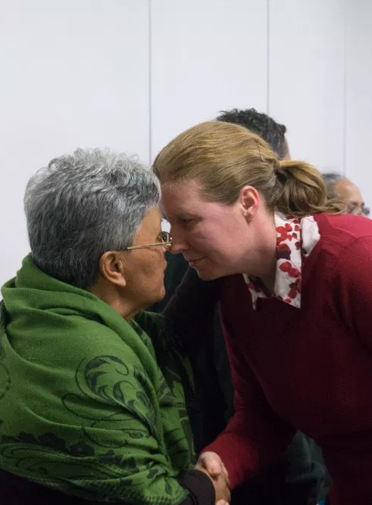
RCT Expectations & Issues
Co-Governance/Co-Management
On-going Involvement
Restoration and Protection of Awa
Address all options including land disposal
Formed The Raukawa Whai Tikanga A Wai Rōpū
Notes:
Engagement at Governance Level and across Council
Avoid Previous Tokoroa process outcomes
On-going involvement
Address all options
Address land disposal
Formed The Raukawa Whai Tikanga A Wai Rōpū
Sought advice from other iwi who’d been through similar process, sought independent expert and facilitator

Slide 7
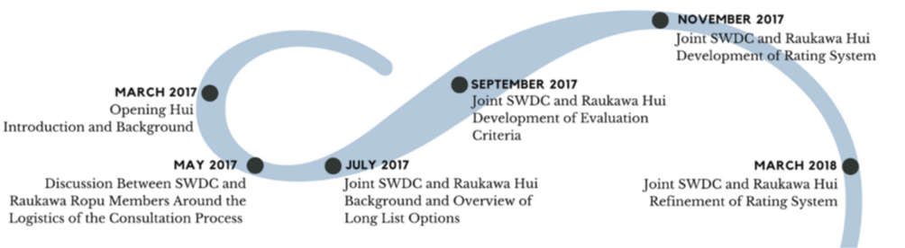
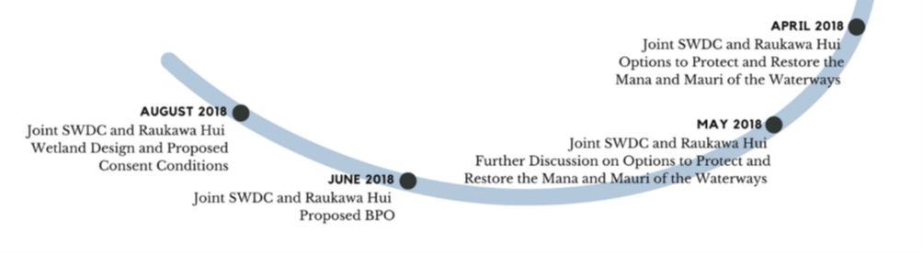
Process
  Investigation of options for protection of water bodies within the takiwā ( i.e water conversation order
Notes:
Attitude important
Joint governance hui elements
Determine joint evaluation criteria to evaluate options
Reviewed possible plant options and solutions – got lost in the detail !!!
facilitated hui - experience in Māori and Council decision making processes
Use of consultants to provide credibility and expertise so that both partners were comfortable
- Attempted to put weighting on criteria - Conceptually good idea. Emotionally awful
- Know when to stop with a process …
Moved to smaller joint working work on detail and concepts ‘agreed’
RMA requirements for engagement and LGA for community engagement
Dave’s notes:
Council and Raukawa in March 2017 were in different places “Their starting place was not ours” – VE
Attitude is as important as process. Acknowledge SWDC and HG staff attitudes.
Both SWDC and RCT spent time planning the joint process in early 2017 to finish by 2017!
Separate hui were also important for SWDC and Raukawa to reach internal agreement
Important time was spent early in the process to develop the relationship and identify common issues.

Slide 8
Evaluation criteria
Significant time spent at joint hui discussing criteria. The criteria agreed were:
The health and wellbeing of the waterbodies is restored and protected for current and future generations
Acknowledgement and protection of cultural values
A wastewater solution that meets the long term needs of the community in a flexible way
Iwi involvement
Economically viable for the community

Slide 9
Health & wellbeing of waterbodies
Rating
1 | 2 | 3 | 4 | 5
Specific Criteria | Means of assessment | Rating
Waterbodies are accessible and safe to swim in and are safe to take kai from all year round. | Measured improvement in effluent bacteriological quality. | 5 - Complete removal of bacteriological contamination from the waterbodies 4 – All treated Effluent from plants is at swimmable levels 3 – 70% of Treated effluent from one plant is at swimmable levels and treated effluent from other is at wadeable levels. 2 –All treated effluent from plants is at wadeable levels 1 – less than 30% or more of total treated effluent is below wadeable levels

Slide 10
Health & wellbeing of waterbodies
Rating
1 | 2 | 3 | 4 | 5
Specific Criteria | Means of assessment | Rating
Reduction in nitrogen levels. | Alignment to Healthy Rivers Wai Ora Plan change. Decrease in annual loads of nitrogen discharged into waterbodies. | 5 - > 85% removed 4 – 70 to 85% removed 3 – 55 to 69% removed 2 – 40 to 54% removed 1 - 25-39% removed
Reduction in phosphorous levels. | Alignment to Healthy Rivers Wai Ora Plan change. Reduction in phosphorous levels. | 5 - > 85% removed 4 – 70 to 85% removed 3 – 55 to 69% removed 2 – 40 to 54% removed 1 - 25-39% removed

Slide 11
Acknowledgement & protection of
cultural values
Rating
1 | 2 | 3 | 4 | 5
Specific Criteria | Means of assessment | Rating
Mauri and mana is safeguarded for present and future generations. Raukawa kaitiaki relationship with their waters is respected, enhanced and supported. | Method of discharge used. | 5 – Discharge to land; no discharge to surface water 3 – Combination of discharge to land and surface water, including appropriate mitigation measures 1 -Discharge to surface water

Slide 12
Meets long-term needs of community
Rating
1 | 2 | 3 | 4 | 5
Specific Criteria | Means of assessment | Rating
Meets future needs (including cultural needs). Continuous improvement | Ability of the solution to be scaled for growth over an agreed period of time. Recognition that resource consents are granted for a maximum of 35 years. Healthy River nutrient reduction targets are meet according to the timeframes set out. Ability of final solution to be staged to match both growth and funding ability. Yearly report back to Rauakwa and the community on the progress made towards the upgrading of the system. | 5 –Fully adaptable technology at all plants 4 – Fully adaptable solution at one plant 3 – Partly adaptable technology 2 - Unadaptable technology at one plant 1 - Unadaptable technology at all plants
Iwi involvement | Option/s for upgrading plants are consistent with the relevant objectives, policies and methods in Te Rautaki Taiao a Raukawa (Raukawa Environmental Management Plan). | 5 – Option is consistent with Te Rautaki Taiao a Raukawa 3 – Some consistency with Te Rautaki Taiao a Raukawa achieved 1 – Inconsistent with Te Rautaki Taiao a Raukawa

Slide 13
Economically viable for community
Rating
1 | 2 | 3 | 4 | 5
Specific Criteria | Means of assessment | Rating
Cost to ratepayers | Effect of CAPEX and OPEX cost on the community | 5 – < 5% increase in rates 4 – to 10% increase in rates 3 – 10 to 14% increase in rates 2 – 15 to 19% increase in rates 1 – 20 to 30% increase in rates
Economic loss due to change in land use | Loss of productive land used for wastewater treatment | 5 – No net loss of land productivity 4 – Net 5 to 50 ha of productive land lost 3 – Net 50 to 100 ha of productive land lost 2 – Net 100 to 150 ha of productive land lost 1 – > 200ha of productive land lost
Notes:
Weighting didn’t work
NB: call out the fiscal limits decided upon –
In conjunction with Raukawa Council had established limits for expenditure based on what seemed possible solutions at the time. $20m capex over 10 years and 20% rate increase to average ratepayer directly attributable to wastewater upgrades

Slide 14
Wastewater Solution
Plant upgrades at Tokoroa, Putāruru and Tīrau – reduce contaminant load
Creation of Land Based Component to WWTP with wetlands for Tokoroa, Putāruru and Tīrau
Wetland’s purpose is to restore the mana and mauri of water bodies affected by wastewater (enhancing the life force)
Mātauranga Māori monitoring
Arapuni looking at risk minimization of for wastewater line crossing river. Already land discharge
Notes:
Wetland details:
Looking for 1 day wastewater retention in wetland
300mm deep to support aquatic life
Treated water flows out as naturally as possible back to stream
Maintenance of water plants, insects and birds is important

Slide 15
Solution Staging
Year |  | Proposed Staging for Discussion with WRC
1 | 2019 | Wetlands for Tirau
2 | 2020 | Sludge Upgrade at Tokoroa - Enabling works for TN and TP upgrades
2 | 2020 | Putauru Sludge Upgrade (additional centrifuge at Tokoroa)
2 | 2020 | Wetlands for Putaruru
3 | 2021 | Wetlands for Tokoroa
4 | 2022 | Tokoroa - TP Upgrade
8 | 2026 | Putaruru TN Upgrade
12 | 2030 | Arapuni
14 | 2032 | Tokoroa - TN Upgrade
22 | 2040 | Putaruru TP Upgrade
27 | 2045 | Tirau TN and TP Upgrade
35 | 2053 | Consent Expiry
Total Capex: $21–29M
Total Opex: $1.4-1.9M

Slide 16
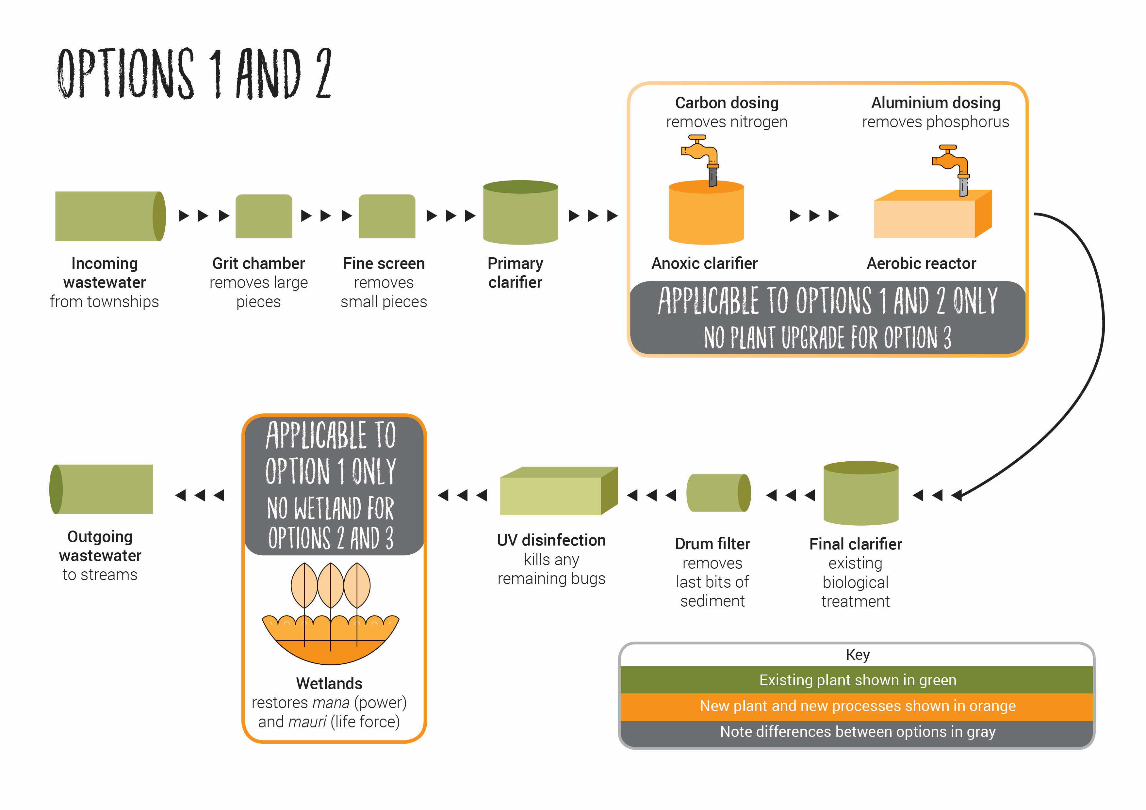
Solution Options

Slide 17
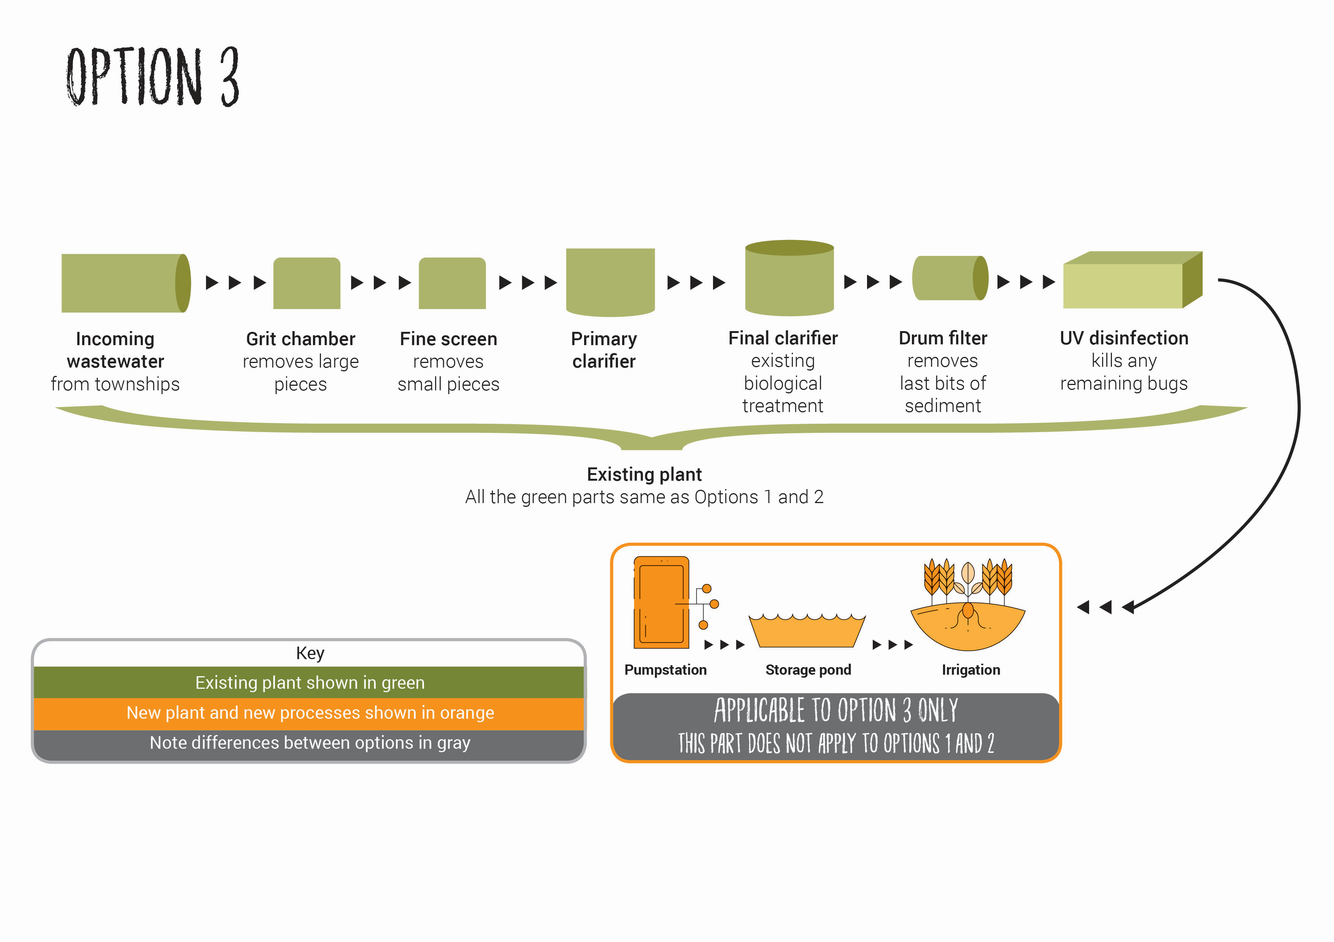
Solution Options

Slide 18
Engagement Process
Other iwi consultation. Important that everyone aware of what is happening
Familiarity with RMA and LGA SCP processes
Different needs and different audiences
Council had committed to go to SCP again with community after LTP

Slide 19
Learnings
Try everything to have real engagement – Joint hui great
Use small joint working groups when gets into too much detail at governance level
Independent technical advisor partially funded by Council provide safety
Separate pre-hui for each party to clarify positions and learnings important
Councils possibly have an expectation of a common 'Māori' or 'iwi' view

Slide 20
Learnings
Independent facilitation with experience in Maori and Council decision making
Join engagement at management and governance levels
Attempted to put weighting on criteria - Conceptually good idea. Emotionally awful - know when to stop with a process …
Allow plenty of time
In summary … just start to talk

Slide 21
Future
Consents lodged on a non-notified basis
Wetland Design
Mātauranga Māori monitoring
Great example of JMA implementation to build engagement model on
Notes:
No Environment Court

