Slide 1

Strategic Planning: Let’s try it
Reflections inspired by
Hutt City’s approach to integrated facilities planning

Slide 2

Stardust brings a new dynamic
A commitment to restore the four well beings to the Local Government Act.
Ministers appear genuinely committed to working collaboratively and dismayed by how some government agencies acted under their predecessors.
Notes:
Emphasise not just new thinking about governance but the implications of the two different policy streams around well-being – Treasury with the living standards framework and councils with a renewed role promoting community well-being.

Slide 3
Stardust brings a new dynamic
It’s a huge shift – this is 2018, not 2002 and governance is understood very differently.
And it’s a two-way street!
Resolving the drinking water crisis.
Notes:
Emphasise not just new thinking about governance but the implications of the two different policy streams around well-being – Treasury with the living standards framework and councils with a renewed role promoting community well-being.

Slide 4

Strategic planning
Describes a preferred future state.
Outlines the proposed means for getting there.
Proposes milestones for measuring progress.
Is aspirational but grounded.

Slide 5
Strategic planning for whom?
The local government dilemma; is strategic planning for:
The Council as an entity?
The communities which the Council serves?
Notes:
This might have been a choice under the previous government. with the new government and the emphasis on well-being, it has to be the communities the Council serves.

Slide 6
Process: The LGA
A prescriptive compliance based framework.
Planning, including the Long Term Plan, sets a business planning compliance framework NOT a strategic planning framework.
A focus on incrementalism.
A bias towards a ‘tick the box’ approach – see the Waikato Mayoral Forum’s S&E Policy template.
Notes:
Engagement is an outcome which can arise out of consultation processes, or other interactions occurring between a local government and its community, such as participation and the gathering and provision of information.
Engagement is achieved when the community is and feels part of the overall governance of that community. Local governments have an important role in building stronger communities, and engaging communities is a key means to doing so.

Slide 7
Process: Strategic planning
Strategic planning as a strategic undertaking.
Strong emphasis on environmental scanning – what trends will impact over the next 10-15 years or more? Who will they impact?
Involvement with stakeholders, those who can help shape or deliver outcomes over the strategic plan period, those who will be impacted.
Notes:
Well-being. The New Economics Foundation’s dynamic model of well-being can help us think through the concept of ‘flourishing’.
Well-being can be understood as the state produced when people lead a good life,
i.e., when they function well, on both a personal and social level.
Functioning well depends on the satisfaction of physical as well as psychological needs, which in turn depends on external conditions such as income, housing, education, on social relationships and connectedness, and on personal resources, such as physical health and degrees of optimism.
The factors that contribute to well-being interact dynamically, so that they can reinforce each other.

Slide 8
Strategic planning continued
It means knowing and understanding your communities, and reflecting their priorities.
It means working collaboratively with others whose actions will influence community well-being.

Slide 9

Strategic planning is aspirational
The key imperative: don’t start from where you are; start from where you aspire to be.
Reflect the aspirations of stakeholders, not the constraints you think will stand in the way.
Attributed to Henry Ford: “If you think you can’t you’re right and if you think you can you’re right”.

Slide 10
An environment of high uncertainty
Some uncertainty is inevitable – we are in a highly dynamic and changing environment.
Much uncertainty should be avoidable – it’s the result of not knowing what’s happening, or not reflecting on the implications of known trends.

Slide 11
An environment of high uncertainty
Example: recent research shows that loneliness is twice as serious a public health risk as obesity.

Slide 12
The Strategic Council
Has clarity of vision and a strong sense of the future it wishes to deliver for itself and its communities.
Understands its primary role as enabling the well-being of its residents.

Slide 13
Strategic Council continued
Realises this means acting as a facilitator, advocate and intervenor regardless of whether it has the formal policy responsibility.
Is highly flexible in how it operates and uses its various tools creatively.

Slide 14
Hutt City Council: A case study
2013 – the journey begins:
We restructured the Community Services group so we could integrate community development into everything we do.
We reallocated the budget and talent to where the need is greatest.

Slide 15
Hutt City Council continued
We started the shift from doing ‘nice’ things to ‘meaningful’.
We put our talent (staff) back into the community by opening an office in the Taita shops.
We began the real planning and community engagement for the Walter Nash Centre.

Slide 16
Hutt City Council continued
YOUth Inspire became established in Wainuiomata.
750 North East kids get up close and personal with the All Blacks – ‘game of 3 halves’ at the Hutt Rec.

Slide 17
Hutt City: The context
Council aware that facilities in Taita were old and tired – a rundown stadium, public hall and library.
Some funding in the budget, and an idea it would be efficient to co-locate, but lack of direction.
High deprivation levels in the city’s northern suburbs.

Slide 18
Hutt City: The game changer
New management appointed for the city’s community services manager.
Council sets 3 priorities;
  run community services,
  we need help with projects,
  we have high deprivation levels and want to do something about it.

Slide 19
Hutt City: The game changer
A new approach: community development disestablished to free up funding.
Extensive community consultation to understand needs and get support.
Establishment of the Community Facilities Trust.

Slide 20
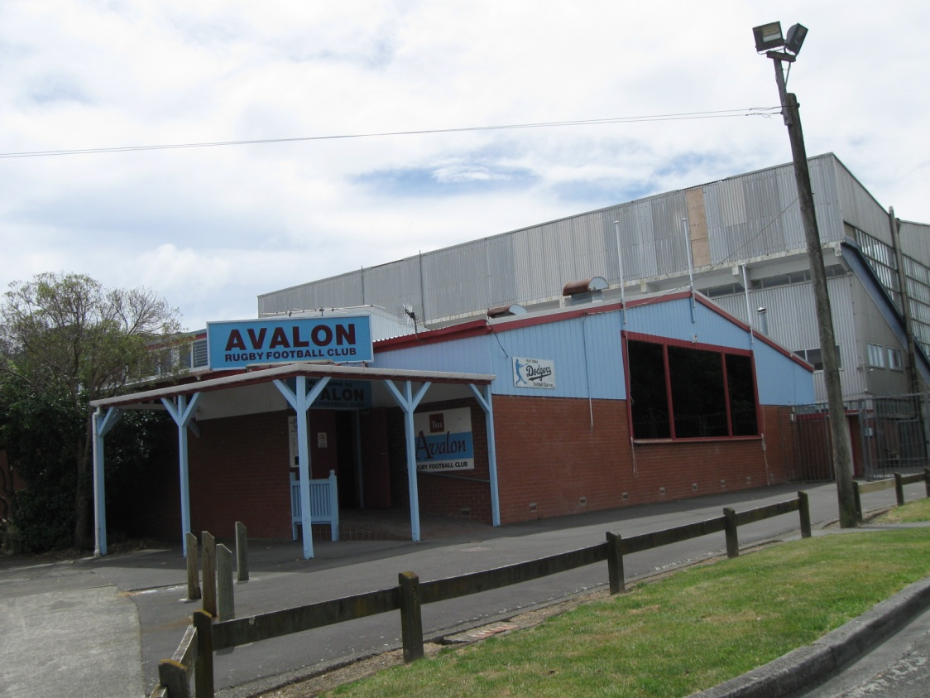
Hutt City: The stadium

Slide 21
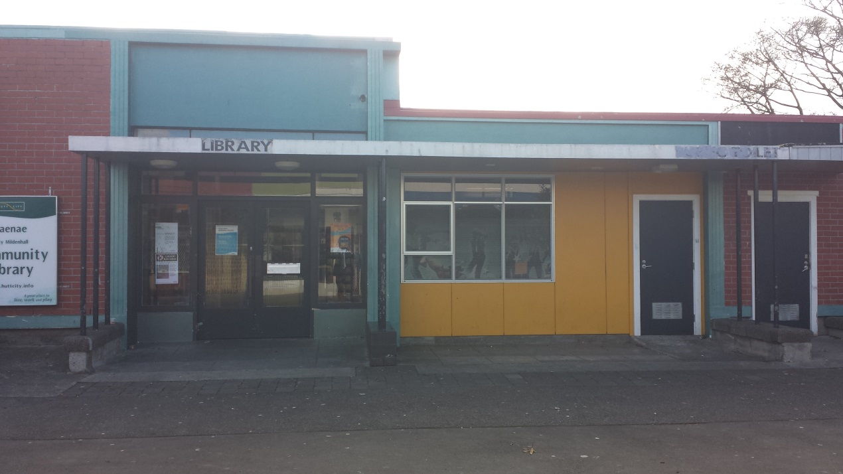
Hutt City: The library

Slide 22
Why the North East focus?
Naenae, Taita, Pomare, Stokes Valley.
Population 16,140 (4,842 are aged between 0-17).
Majority in deprivation 9 or 10 (city wide: 22,500 people).

Slide 23
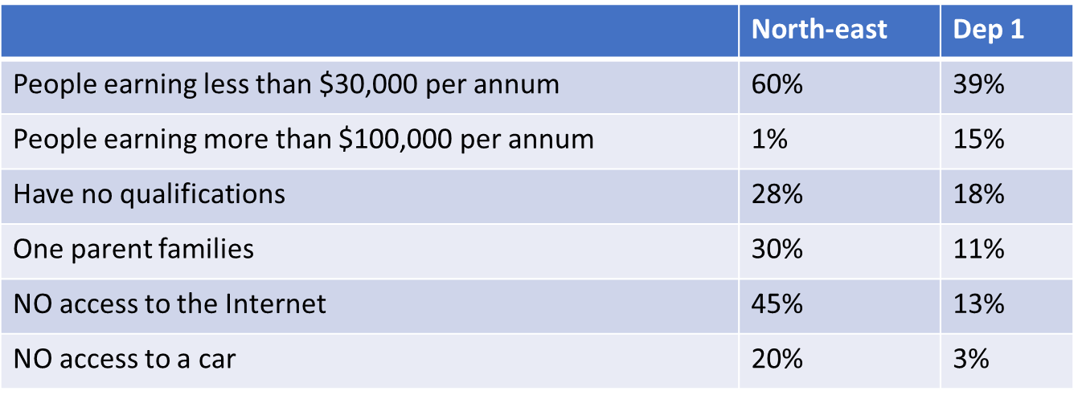
North East focus continued

Slide 24
North East focus continued
Police say “most vulnerable areas of crime in region”.
3 times more likely to be hospitalised with an infectious disease.
Highest levels of avoidable hospitalisations (per 1,000):
Taita 37 Naenae 33 DHB average 18

Slide 25
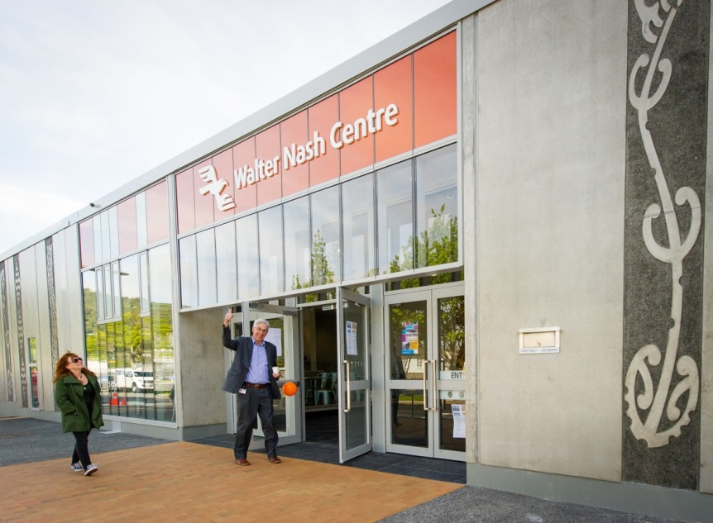
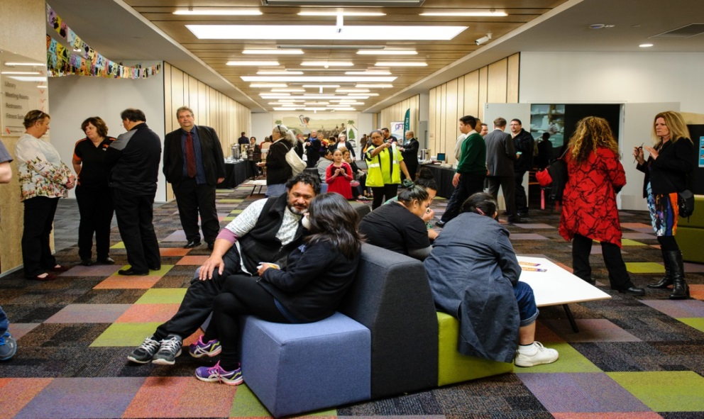


Fast forward: Walter Nash centre

Slide 26
The rediscovery of community
Minister of Health David Clark in a wide ranging discussion on youth suicide:
“Part of it at some level has to do with the kind of society we have become. We are a more atomised society. People are not as engaged, in many cases, with their communities, partly driven by a lack of financial resources. They are working long hours, in jobs where they are isolated.”
Notes:
The strategic risk and resilience panel is a central government body hosted by the Department of Prime Minister and cabinet.
The panel brings together a range of experts drawn from both inside and outside of government with a brief to assist the officials committee for domestic and external security coordination and provide an advisory and critiquing role in relation to strategic national security risks and how they are addressed by the system as a whole.

Slide 27
The rediscovery of community
Central government regime change – from “stick to core services”, to build resilient communities.
Strategic Risk and Resilience Panel states there was a need for "a more forward looking approach in particular focused on community cohesion."

Slide 28
Councils at a cross roads
Let’s make it a stark choice between:
The compliance Council completing and consulting on the various planning and accountability documents required by legislation on a ‘business as usual’ basis.
The ‘well-being’ Council, working with its communities with a mutual objective of ensuring everyone has the best opportunity to satisfy their physical and psychological needs.

Slide 29

The ‘well-being’ Council
Aware of the inherent limits on central government capability.
Understands the potential of local leadership and the importance of working in partnership.
Has a long term strategic focus informed by a deep interest in the ways in which different megatrends could impact on its communities.

Slide 30
The ‘well-being’ Council
Makes creative use of the various powers available to it in the interests of the different communities serves.
Puts its continuous improvement focus on developing the strategic capability of the people who work with it, and the people and entities with which it partners in its local communities.

Slide 31
Conclusion
Strategic planning should be a core function for New Zealand councils focused on based on enabling and facilitating the well-being of their communities.
New Zealand councils have as much opportunity to be strategic in the way they function as any of their counterparts internationally.

Slide 32
Conclusion continued
Operating strategically will require major changes in organisational culture and practice.
The new government’s policy settings will at least provide an incentive for change.

Slide 33
Any questions ?

